Slide 1
Having Fun with Sight Words and More! Kit
Abby Weisz and Ashley Wanner

Slide 2
Items included within the Kit
2 standards
6 Lesson Plans
LakeShore Learning Materials

Slide 3
Materials: LakeShore Learning

Slide 4
Materials: LakeShore Learning

Slide 5
Materials: LakeShore Learning

Slide 6
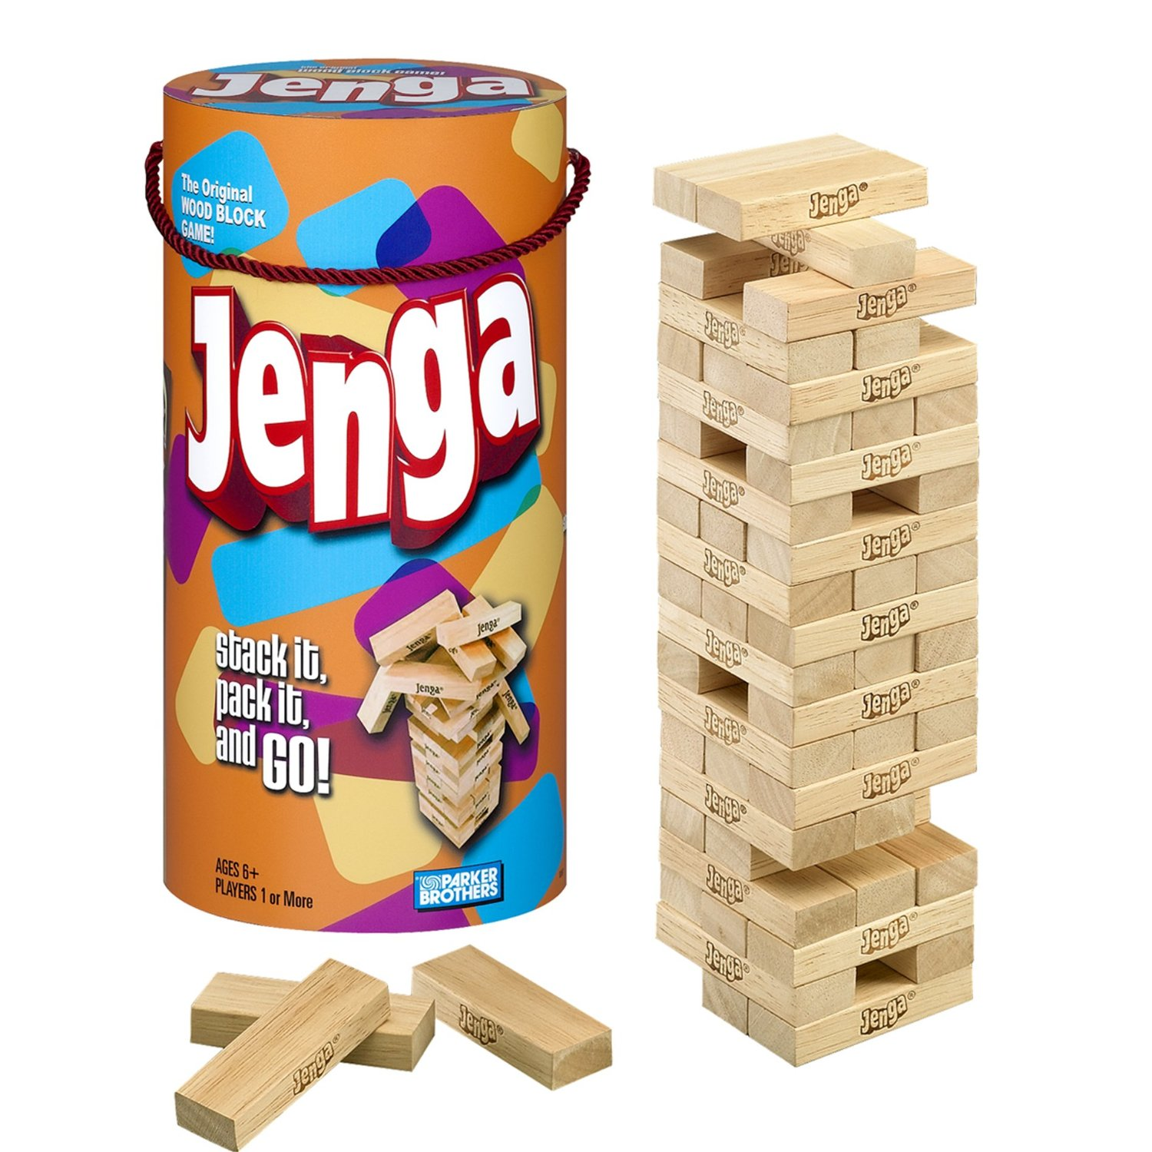
Materials: Jenga
Target: $8.79

Slide 7
Language Arts Standards
Language Standards:
Conventions of Standard English
K.L.1e
Demonstrate command of the conventions of standard English grammar and usage when writing or speaking. Use the most frequently occurring prepositions (e.g., to, from, in, out, on, off, for, of, by, with).
K.L.1b
Demonstrate command of the conventions of standard English grammar and usage when writing or speaking. Use frequently occurring nouns and verbs.

Slide 8
Language Arts Standard
Reading Standards: Foundational Skills:
Phonics and Word Recognition
K.RF.2
Demonstrate understanding of spoken words, syllables, and sounds (phonemes).
K.RF.3a
Know and apply grade-level phonics and word analysis skills in decoding words. Demonstrate basic knowledge of one-to-one letter-sound correspondences by producing the primary or many of the most frequent sounds for each consonant.
K.RF.3c
Know and apply grade-level phonics and word analysis skills in decoding words. Read common high-frequency words by sight. (e.g., the, of, to, you, she, my, is, are, do, does).

Slide 9
Lessons and Objectives
Lesson 1
Standard: K.RF.3c.
Objective: The student will apply his/her knowledge of sight words to read common high-frequency words by sight with 90% accuracy.
Used during Daily 5
Rules of the game:
Use a sand timer - you will have 30 seconds to pick up and read as many sight words as possible.
After the 30 seconds write down the sight words you know and had trouble with
Count the words you got right and the ones you had trouble with
The next time you play see if you know more words!

Slide 10
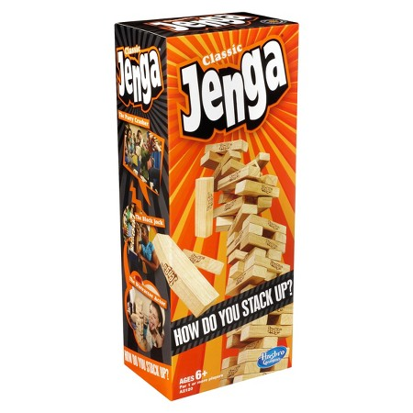
Lessons and Objectives
Lesson 2
Standard: K.RF.3c
Description: Read common high-frequency words by sight. (e.g., the, of, to, you, she, my, is, are, do, does, he)
-Use a standard Jenga Set with a sight word written on each piece
-Students can either play individually or in a group
-Once they draw a Jenga Piece, the student then has to say the sight word, spell it, and if they want the teacher can use the sight word in a sentence

Slide 11
Lessons and Objectives
Lesson 3
Standard: K.L.1e
Objective: The student will command his/her knowledge of prepositions by reading and writing them with 90% accuracy.
Used during Daily 5
Rules of the game:
Use a sand timer - you will have 30 seconds to pick up and read as many prepositions as possible.
After the 30 seconds write down the prepositions you know and had trouble with
Count the prepositions you got right and the ones you had trouble with
The next time you play see if you know more prepositions!
Use the known and unknown preposition list at the Writing Center. Have students create sentences with their prepositions.

Slide 12
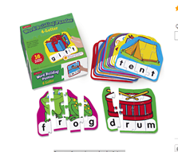
Lessons and Objectives
Lesson 4
Standard: K.RF. 3a
Description: Demonstrate basic knowledge of one-on-one letter sound correspondences by producing the primary or many of the most frequent sounds for each consonant
Game: 4 Letter Word Building Puzzle
-Scatter letters or puzzle pieces out either on the floor or table
-Have the students work on putting the puzzle pieces together to form a word (this can be done in groups or for individual practice)

Slide 13
Lessons and Objectives
Lesson 5
Standard: K.RF.3
Objective: The student will demonstrate understanding of syllables by reading, pronouncing, blending, and segmenting the syllables into spoken words with 90% accuracy.
Used During Daily 5
Rules of the Game
Pick a card and follow the directions.
Use syllables to help sound out the word. Clap out the two syllable words if you need to.
If the word is correctly pronounced take the amount of tokens indicated on the card.

Slide 14
Phonics continued….
Close up of the cards

Slide 15
Lessons and Objectives
Lesson 6
Standard: K.L.1b
Description: Use frequently occurring nouns and verbs
Game: Jenga set
-Set up a normal game of Jenga, except have there be a different noun or verb on each piece
-The students can be separated into teams of about 4 to 6 people.
-Everytime they pick a Jenga piece with the noun or verb, they have to either describe it or act out the word. If they get it right they get the point, if they don’t they don’t get the point.

