Slide 1
Observable properties kit
Created by Sydney Arman and Ashley Wanner

Slide 2
Kit Explanation:
Standard: 2-PS1-1:Plan and conduct an investigation to describe and classify kinds of materials by their observable properties
Has a variety of activities that help students identify different objects by their characteristics and properties.

Slide 3
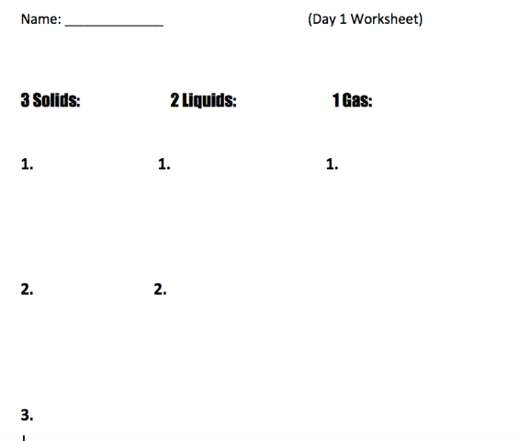
Lesson 1: Identifying solids, liquids, and gases
Read a book on properties
Scavenger hunt-find 3-2-1
How did you know it was a solid (liquid, gas)?

Slide 4
Lesson 2: Properties of Matter
Showing a video on observable properties
Teacher shows objects from the kit to class and discuss about the properties as a group
“Think, pair, share”-students will get into groups and discuss properties of objects placed in their groups.

Slide 5
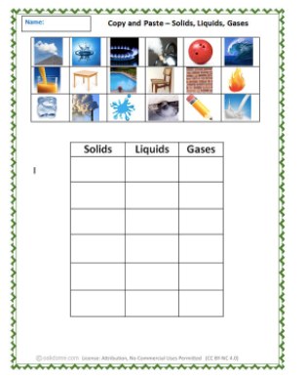
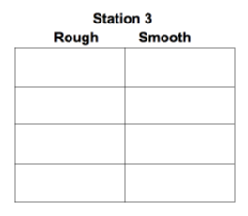
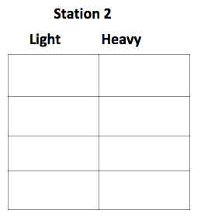
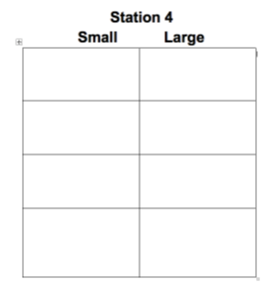
Lesson 3: Small Group Stations

Slide 6
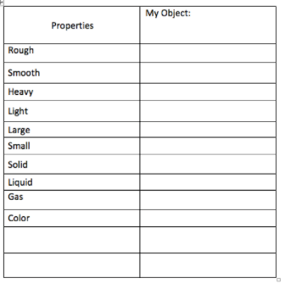
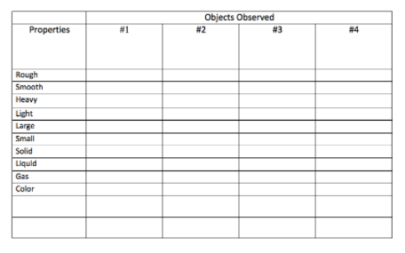
Lesson 4: “Your turn”
Students are to bring an object of their choice from home to school for peers to record observable properties.

Slide 7
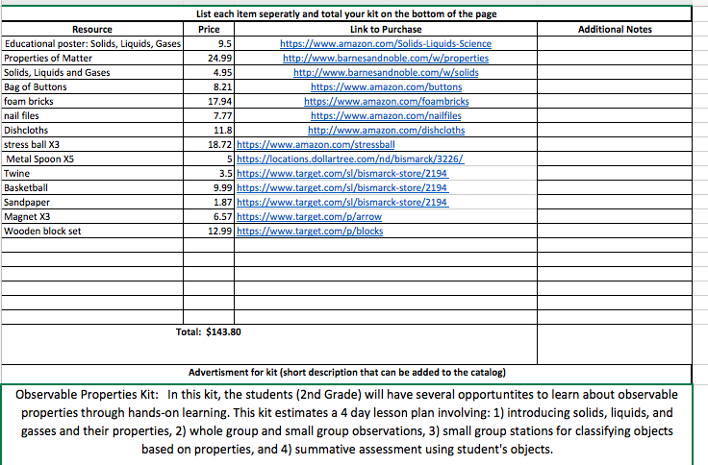
Total Cost of Kit:

